Slide 1
Reddit Insurance Topic Modeling Report
CAO Chaofan

Slide 2
Contents
01
02
Introduction
Data Collection
03
04
Statistical Analysis
LDA Topic Modeling
05
06
Temporal Trend Analysis
Conclusion

Slide 3
Introduction
PART 01

Slide 4




Research objectives
Understanding public sentiment toward insurance providers has become crucial for strategic decision-making.
delving into the rich landscape of Reddit discussions to uncover how consumers perceive and talk about major insurance companies.
Aimming to identify the dominant topics and sentiments that characterize online discourse about insurance services.

Slide 5

Research Subjects
Our analysis focuses on five insurance giants that dominate Hong Kong's competitive market landscape : AIA, AXA, Manulife, Prudential, Sun Life.
We selected these five companies not merely for their market dominance, but for the rich tapestry of consumer discussions they generate online. Their diverse origins (pan-Asian, European, and North American), varied product emphases, and different market positioning strategies create an ideal comparative framework for understanding how consumers perceive and discuss insurance providers across cultural and operational dimensions.

Slide 6
Data Collection
PART 02

Slide 7


Objectives
Tap directly into the unfiltered consumer consciousness regarding AXA, Manulife, Prudential, AIA, and Sun Life.
Methodology
Engineered a custom data harvesting pipeline using Python and the PRAW (Python Reddit API Wrapper) library to systematically mine the platform's rich discussion archives
Connection
Connected to Reddit using the provided Reddit API credentials and accessed the relevant forum content.

Slide 8
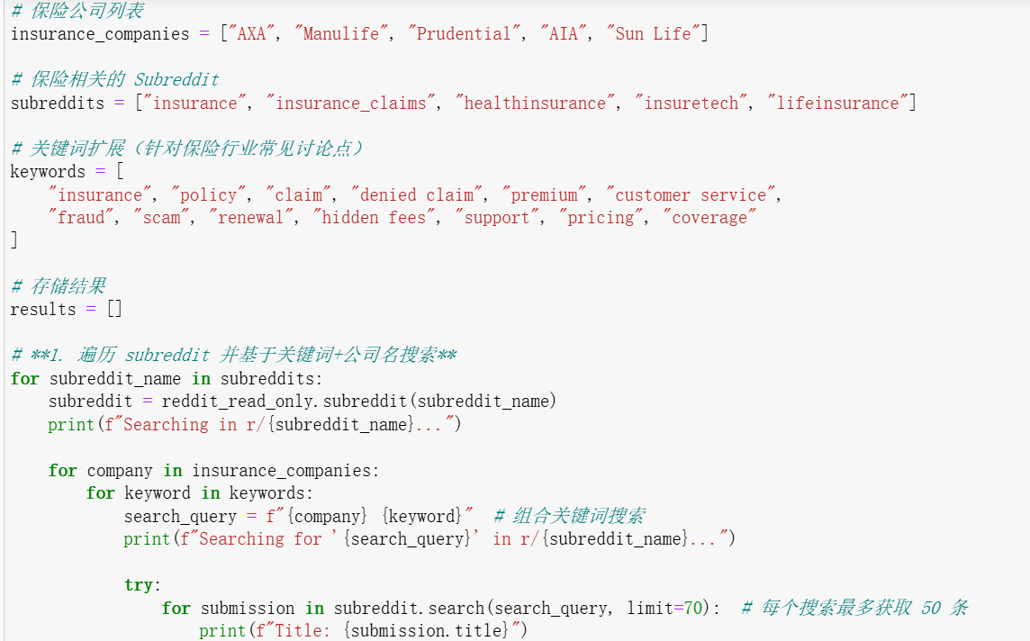
Strategy
01
Target Subreddits
To ensure comprehensive data coverage, I selected five insurance-related subreddits, which host discussions on different aspects of insurance, claims, policies, and industry trends:
[‘insurance’,’insurance_claims’,’healthinsurance’,’insuretech’,’lifeinsurance’]
02
Search Strategy
For each of the five major insurance companies (AXA, Manulife, Prudential, AIA, Sun Life), I performed searches using a combination of company names and insurance-related keywords, such as:
["insurance," "policy," "claim," "denied claim," "premium," "customer service," "fraud," "scam," "renewal," "hidden fees," "support," "pricing," and "coverage."]

Slide 9
Data structure(JSON)
{
"subreddit": "insurance",
"company": "Sun Life",
"title": "what is the reasonable price for a young person?",
"url": "https://www.reddit.com/r/Insurance/comments/7g... ",
"score": 0,
"num_comments": 3,
"created_utc": "2017-11-30 15:02:03",
"content": "As mentioned, I’m looking for (health & dental...",
"comments": [
{
"author": "Cicatrizad",
"body": "Alberta?",
"score": 2
}
}
Data Volume
5062 posts containing data on insurance companies, insurance-related keywords, and subreddit information.
The comments embedded within these threads—over 118,000 in total—provide the crucial context and community response
The temporal scope of our dataset spans nearly a decade and a half, stretching from October 26, 2011, to February 24, 2025
Example

Slide 10
Statistical Analysis
PART 03

Slide 11
Data Cleaning
Removing Uninformative Content
Discarded posts with “deleted” or “removed” in either content or title
Eliminated posts with fewer than 10 characters
Output:
Final posts: 4,886
Final comments: 118,046
Preserving Valuable Short Posts
If content was missing but title was meaningful, used title as substitute
Structuring Comments for Independent Analysis
Extracted comments into a separate table
Key fields preserved: Company, Subreddit, Post Title, Comment Text, Comment Score

Slide 12
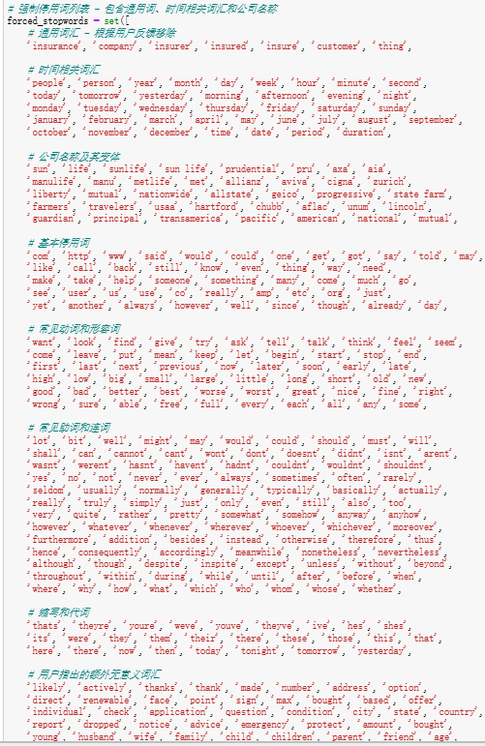
Text Preprocessing
1. Standardization & Tokenization
Lowercased all text
Split into individual tokens (words)
2. Filtering Noise
Removed NLTK stopwords and manually identified high-frequency terms, such as:
“insurance”, “company”, “year”, “http”, “said”
3. Lemmatization
Standardized word forms: e.g., “claims”, “claimed” → claim
4. Final Cleaning
Removed entries with empty or meaningless cleaned text

Slide 13
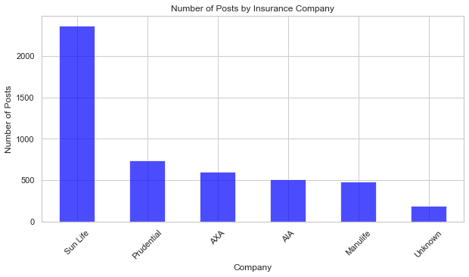
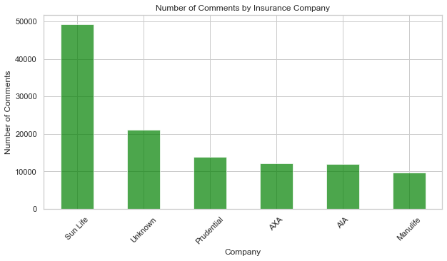
Analysis
Distribution of Posts and Comments by Company
Sun Life has the highest number of posts and comments, indicating significant discussions. Other insurers, like Prudential and AXA, also generate notable engagement, while "Unknown" suggests discussions where no specific company is mentioned.

Slide 14
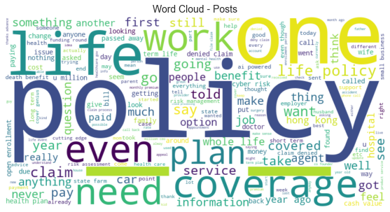
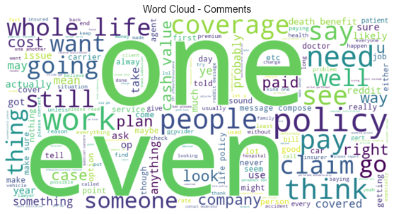
Analysis
Word Cloud Analysis
Word clouds for posts and comments reveal common terms such as "policy," "coverage," "claim," and "life," indicating key discussion topics. Comments show a more conversational nature, with frequent words like "one," "ever," and "work."

Slide 15
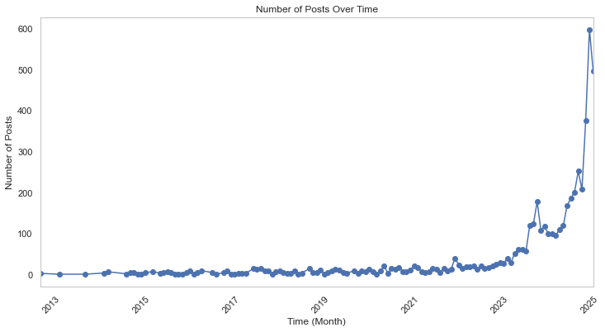
Analysis
Temporal Trends
The number of posts has surged since 2021, particularly in 2023 and 2024. This suggests an increasing interest in insurance discussions, possibly driven by regulatory changes, market shifts, or consumer concerns.

Slide 16
LDA Topic Modeling
PART 04

Slide 17
Methodology
Text Preprocessing
Company Modeling
Output Results
1.Each Reddit record is combined into a single document
2.Standard natural language preprocessing techniques include tokenization, lemmatization, and stopword removal
1.A separate LDA model for each insurance company to uncover discussion patterns
2.Each topic is characterized by its most salient keywords, which help describe the main themes
1.Keyword Rankings for Each Topic
2.Topic Distribution Bar Chart
3.Word Cloud Visualizations
4.Document-topic matrix

Slide 18
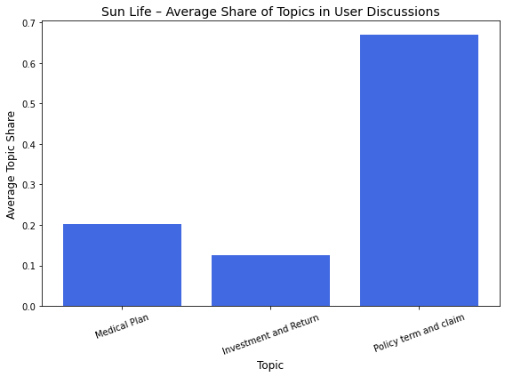
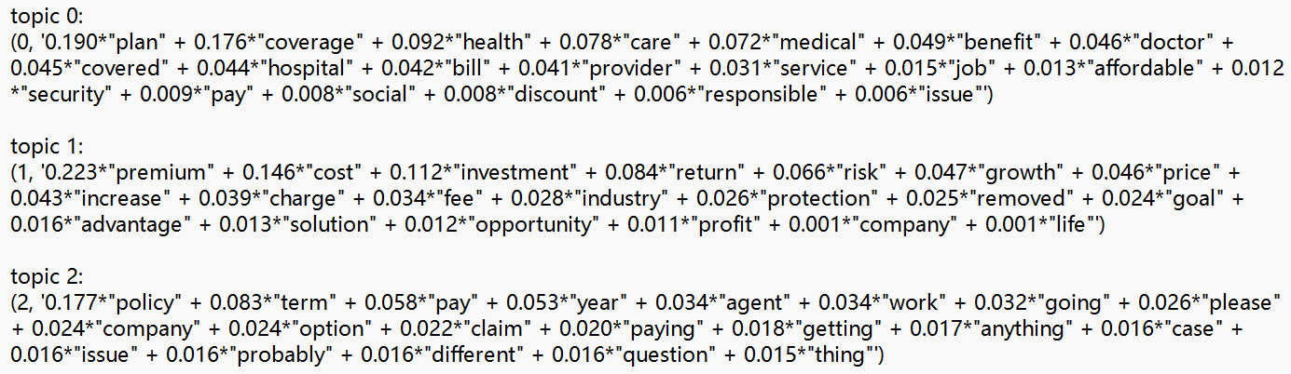
Result
Topic 0 :Medical Plan - Focuses on healthcare insurance coverage, medical services, and provider-related concerns.
Topic 1 : Investment and Return-Reflects discussions about financial returns, policy profitability, and user expectations on investment value.e.
Topic 2 : Policy term and claim（保单条款和索赔）-Centers on policy structures, claim procedures, and user confusion or inquiries around contract details.
SunLife
Users are especially focused on clarifying policy terms and addressing ambiguities in coverage

Slide 19
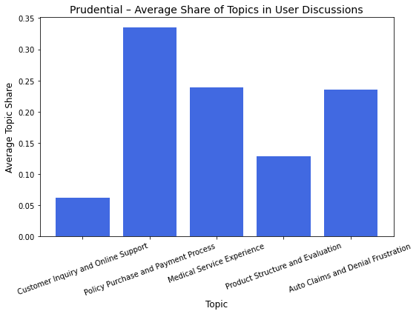
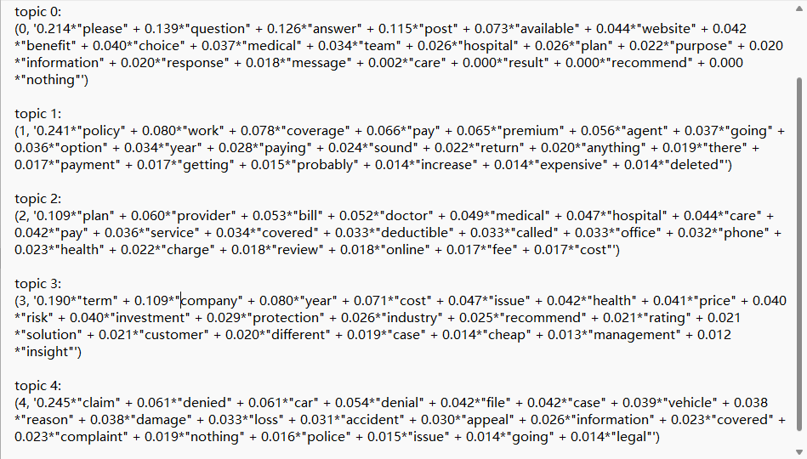
Result
Customer Inquiry and Online Support – Captures users asking questions or seeking help online, often through posts or website interactions, especially regarding medical or benefit-related topics.
Policy Purchase and Payment Process – Reflects user experience with buying insurance, discussing policy terms, premiums, agents, and affordability concerns.
Medical Service Experience – Focuses on user interactions with doctors, hospitals, and service providers, including billing, deductibles, and coverage clarity.
Product Structure and Evaluation – users analyzing plan structure, investment value, health-related cost concerns, and comparing products across providers.
Auto Claims and Denial Frustration – Highlights frustration around denied claims, especially in car accidents, and includes terms like “appeal”, “loss”, and “police
Prudential
users’ strong focus on understanding their insurance coverage and payment mechanisms.

Slide 20
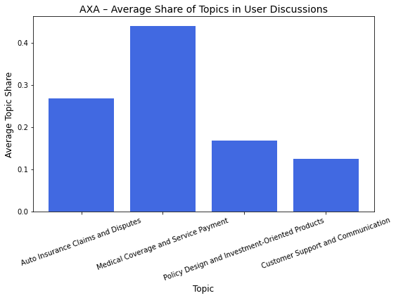
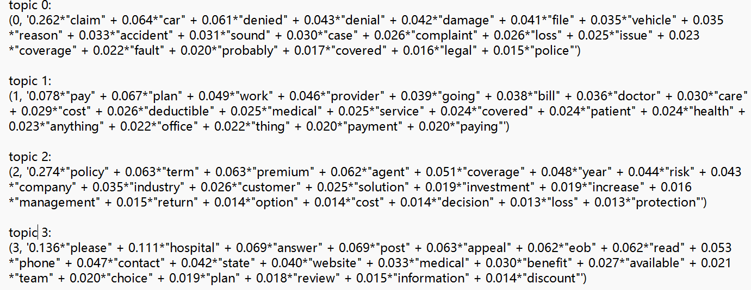
Result
Topic 0: Auto Insurance Claims and Disputes – Focuses on user frustrations related to denied claims, car damage, and accident-related processes.
Topic 1: Medical Coverage and Service Payment – Emphasizes treatment-related expenses, insurance coverage during care, and provider-side payment concerns.
Topic 2: Policy Design and Investment-Oriented Products – Reflects user considerations about policy terms, investment returns, risk management, and insurer communication.
Topic 3: Customer Support and Communication – Captures user efforts to seek help or clarification through phone calls, websites, or appeals, often in a medical context.
AXA
Users’ concerned with practical cost and payment issues during actual medical service use..

Slide 21
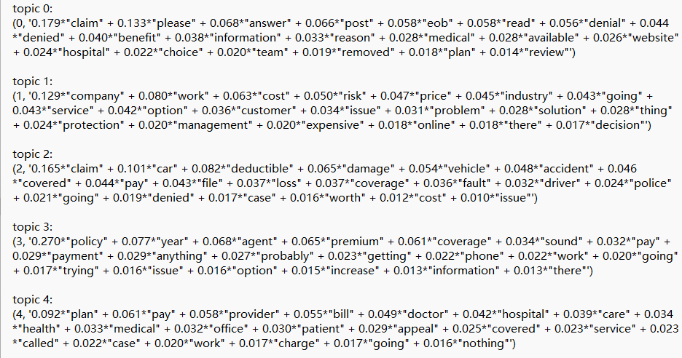
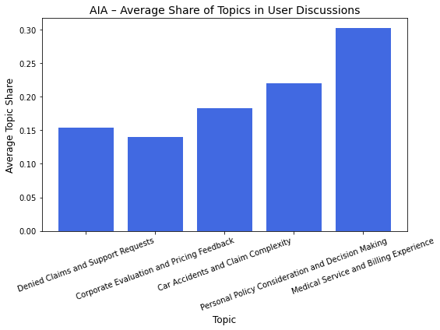
Result
Denied Claims and Support Requests – Captures user frustration around claim denials and follow-up efforts through posts or support channels (e.g., EOB, website, answer, review).
Corporate Evaluation and Pricing Feedback – user opinions on AIA as a company, including critiques of pricing, service quality, and perceived lack of value in offered products.
Car Accidents and Claim Complexity – Focuses on auto-related incidents, with mentions of deductibles, police, coverage disputes, and out-of-pocket costs.
Personal Policy Consideration and Decision Making – Highlights individual-level deliberation before purchase, featuring uncertainty, comparison of options, and consultation with agents..
Medical Service and Billing Experience – Emphasizes provider interactions and billing clarity in medical contexts, including appeals, doctor visits, and service-related complaints.
AIA
users care most about accessing and affording healthcare services under their plans

Slide 22
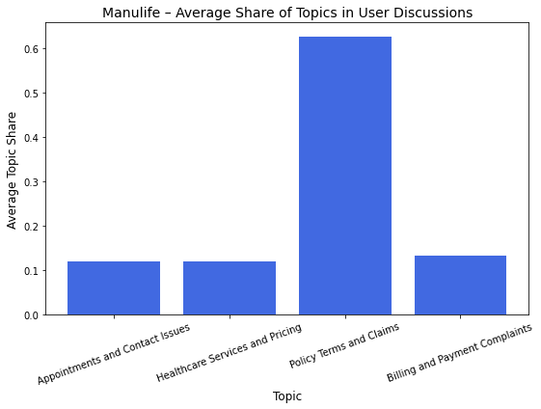
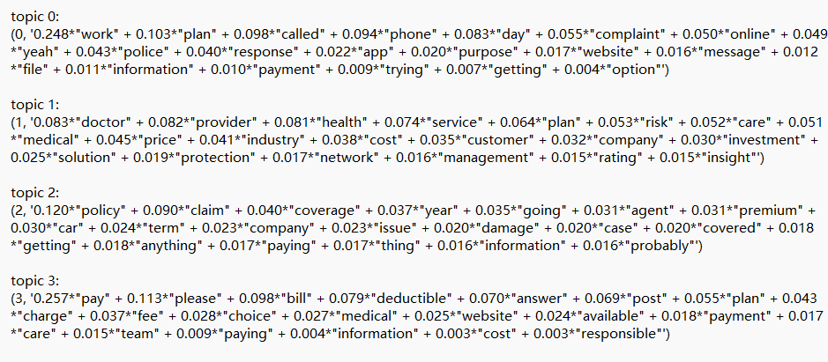
Result
Appointments and Contact Issues – users reaching out via phone or online tools (e.g., app, website) to resolve complaints, make appointments, or clarify issues related to their plans.
Healthcare Services and Pricing –user experiences with doctors, providers, and health services, often accompanied by concerns about pricing, plan coverage, and service quality.
Policy Terms and Claims –user discussions about insurance contracts, claim procedures, and related concerns, especially in the context of auto-related incidents and policy interpretation.
Billing and Payment Complaints –frustrations with payments, billing clarity, and extra fees such as deductibles or charges, including users expressing dissatisfaction or confusion online.
Manulife
users are primarily focused on resolving insurance claims and understanding policy coverage in accident scenarios

Slide 23
Topic discussion
Topic Category | Mapped Topics by Company
Claims & Disputes | Sun Life: Policy term and claim AXA: Auto Insurance Claims and Disputes Prudential: Auto Claims and Denial Frustration AIA: Car Accidents and Claim Complexity, Denied Claims and Support Requests Manulife: Policy Terms and Claims
Medical Services & Billing | Sun Life: Medical Plan AXA: Medical Coverage and Service Payment Prudential: Medical Service Experience AIA: Medical Service and Billing Experience Manulife: Healthcare Services and Pricing, Billing and Payment Complaints
Policy Design & Purchase Decision | Sun Life: Investment and Return AXA: Policy Design and Investment-Oriented Products Prudential: Policy Purchase and Payment Process, Product Structure and Evaluation AIA: Corporate Evaluation and Pricing Feedback, Personal Policy Consideration and Decision Making
Customer Support & Interaction | AXA: Customer Support and Communication Prudential: Customer Inquiry and Online Support AIA: Denied Claims and Support Requests Manulife: Appointments and Contact Issues

Slide 24
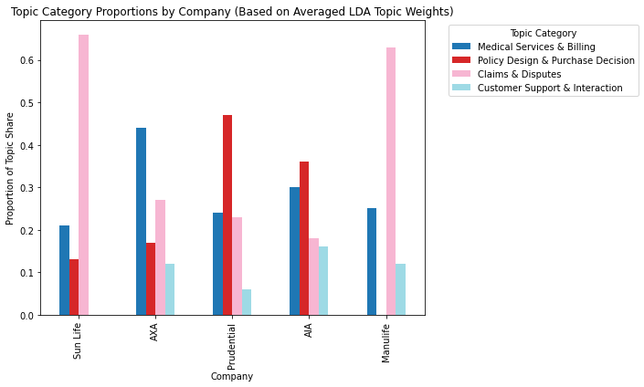
Topic discussion
1．Claims & Disputes is the dominant concern for Sun Life and Manulife, highlighting user frustrations with policy interpretation and claims.
2．Medical Services & Billing accounts for a large share in AXA and AIA, indicating users' attention on cost transparency and payment support during treatment.
3．Prudential stands out in Policy Design & Purchase Decision, suggesting a strong focus on product understanding, affordability, and insurance buying behavior.
4．Customer Support & Interaction remains relatively secondary across all companies but still visible in AXA, Prudential, and AIA, pointing to service communication issues.

Slide 25
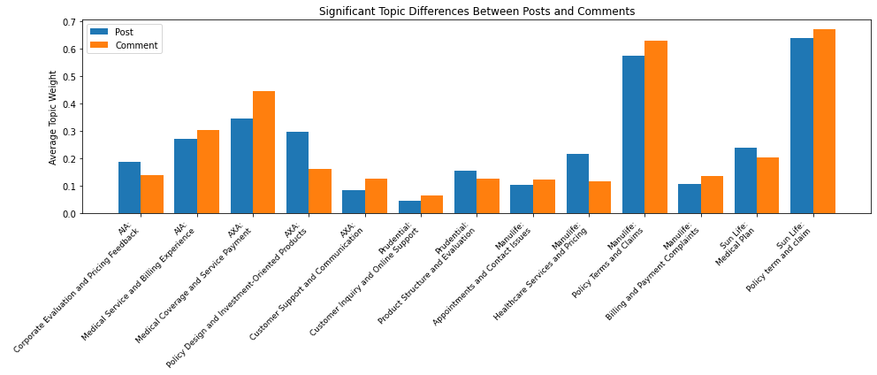
Topic Differences Between Posts and Comments
This analysis reveals consistent structural differences in user expression between posts and comments across different insurance topics:
l Posts are often used for initiating intent-driven queries and raising strategic concerns;
l Comments are more likely to contain detailed reactions, clarifications, or user-sourced validation.

Slide 26
Topic Temporal Trend Analysis
PART 05

Slide 27
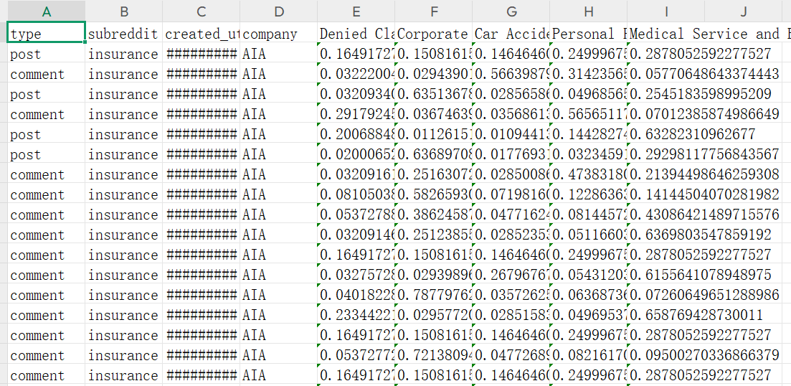
To investigate how user concerns evolve over time, we first constructed a monthly topic-document matrix for each company. This was done by aggregating individual topic weights by month and calculating the average topic share across all documents within the month. The resulting trends reflect how discussion topics rise or fall in popularity over time, providing insights into shifting consumer priorities and concerns.
This temporal analysis covers the entire dataset timeframe from October 2011 to February 2025, allowing us to observe long-term patterns and identify significant shifts in consumer discourse. The methodology enables us to track not only which topics dominate discussions at different points in time but also how the relative importance of various concerns has evolved throughout this 14-year period.

Slide 28
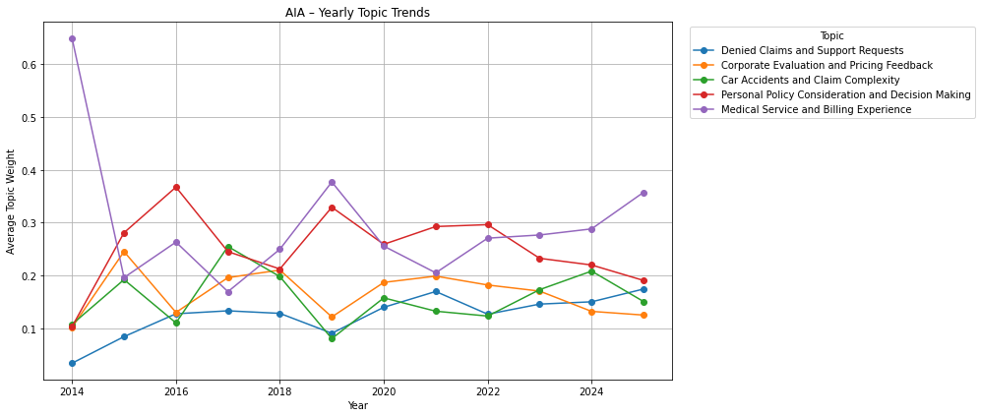
AIA Trend
Phenomenon 1: 2014 Surge in "Medical Service and Billing Experience" Topic
Phenomenon 2: 2015–2019 Inverse Trends Between "Personal Policy Consideration and Decision Making" and "Corporate Evaluation and Pricing Feedback"

Slide 29
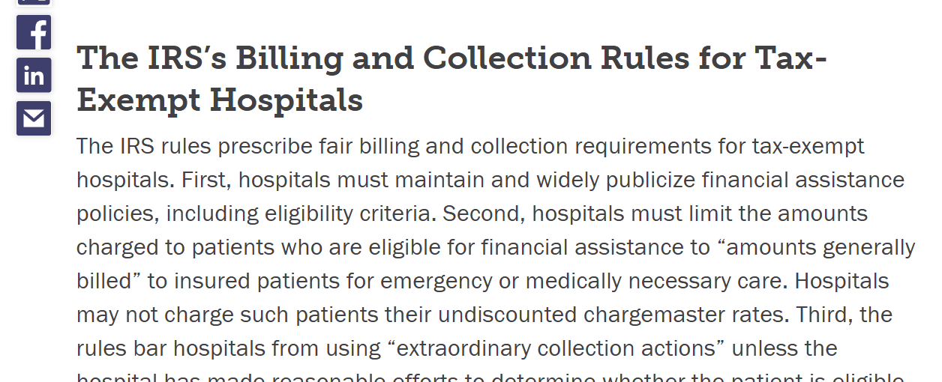
Phenomenon 1: 2014 Surge in "Medical Service and Billing Experience" Topic
in December 2014, the U.S. Internal Revenue Service (IRS) issued final rules under the Affordable Care Act aimed at curbing aggressive hospital billing and collection practices. These regulations were designed to protect patients from unexpected medical bills and to promote fair billing standards.
Phenomenon 2: 2015–2019 Inverse Trends Between "Personal Policy Consideration and Decision Making" and "Corporate Evaluation and Pricing Feedback"
When one topic's prominence increased, the other's tended to decrease. This pattern may reflect shifts in consumer focus influenced by AIA's strategic initiatives during that time. For instance, AIA introduced several innovative insurance products and digital tools aimed at enhancing customer engagement and personalized policy management.

Slide 30
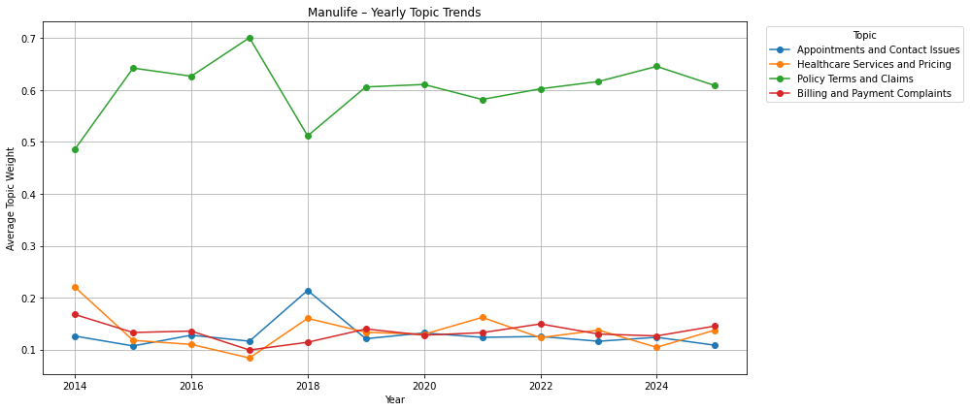
Manulife Trend
The topic “Policy Terms and Claims” consistently dominates user discussions from 2014 to 2025, with average weights typically above 0.6. This indicates that customers of Manulife are persistently focused on understanding contract details, claim rules, and benefit eligibility—suggesting potential complexity or confusion in policy language or service transparency.

Slide 31
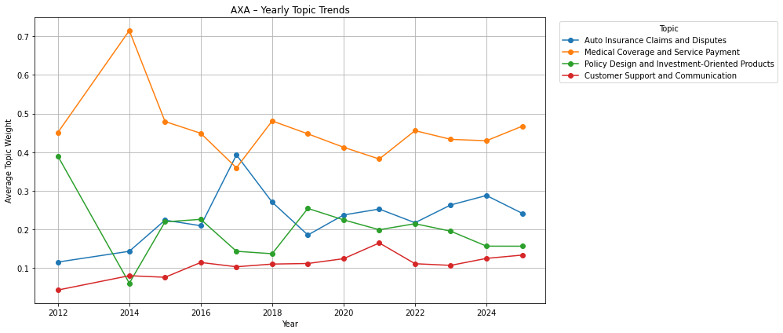
AXA Trend
Dominance of Medical Coverage and Service Payment
Throughout the observed period, the topic “Medical Coverage and Service Payment” consistently dominates user discussions related to AXA. This indicates a sustained public interest in AXA’s health-related services, likely reflecting the company’s strong market presence in Hong Kong’s medical insurance sector.

Slide 32
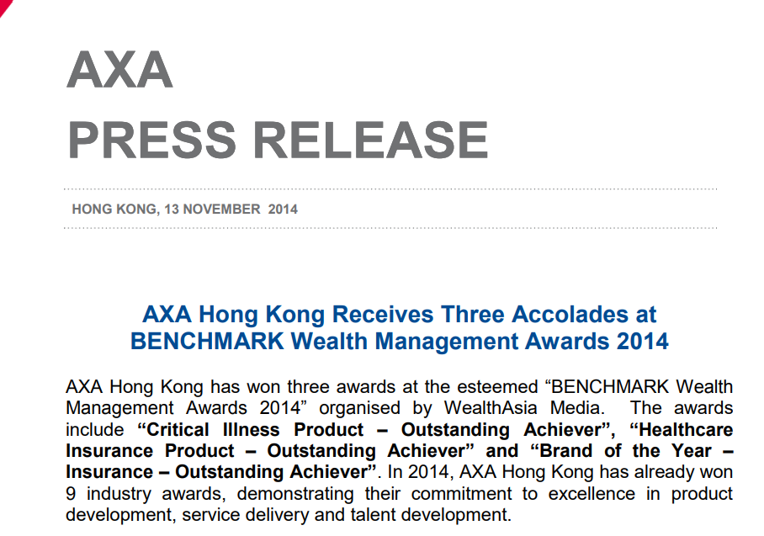
AXA Trend
Inverse Trend Between Medical and Investment Topics (2012–2015)
From 2012 to 2015, a clear inverse trend is observed between “Medical Coverage and Service Payment” and “Policy Design and Investment-Oriented Products.” While interest in medical coverage surged, investment-related topics declined. This divergence may be attributed to AXA’s strategic emphasis on medical insurance during that period. Notably, the company launched the HealthVital Major Illness Insurance Series in 2014, which gained significant public attention and awards. This focus likely redirected user discussions away from investment products toward health coverage.

Slide 33
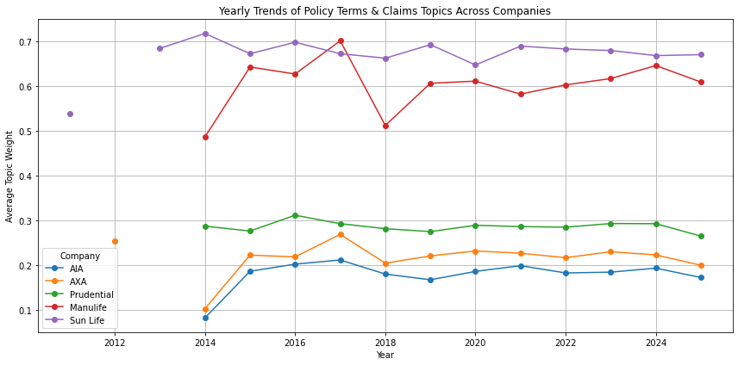
Cross-Company Comparison
Policy Terms and Claims
To further explore differences in user concerns, we selected the topic of "Policy Terms and Claims" and compared its annual trends across five insurance companies. The visualization and insights are as follows
1.Sun Life dominates in claim-related discussions, maintaining the highest topic weight (0.66–0.72) since 2013, indicating consistent user engagement—possibly due to complaints, complexity, or regulatory pressure.
2.Manulife showed a sharp rise around 2015, and has since maintained a high level of user attention (around 0.60+), likely due to internal policy changes, communication issues, or external events triggering public discussion:

Slide 34
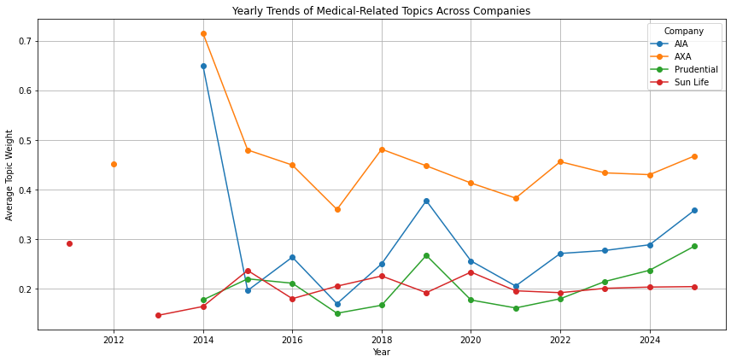
Cross-Company Comparison
Medical topic trends
To better understand how public interest in medical-related topics varies across major insurance companies over time, we aggregated topic weights annually and plotted the trends from 2011 to 2025. The line chart below presents a comparative view of the evolving attention paid to medical topics, such as Medical Coverage and Service Payment or Medical Plan, across four major providers: AXA, AIA, Prudential, and Sun Life.

Slide 35
Time Series Summary & Strategic Implications
Key Insights (2011–2025)
Medical topics dominate across firms; AXA & AIA trend highly synchronized, both peaked in 2014.
Sun Life & Manulife show persistently high focus on Policy Terms & Claims (e.g., Sun Life: 0.66–0.70).
AIA shows internal topic trade-offs: pricing ↑ vs. personal concerns ↓ (2015–2019).
2024–2025 surge in medical concerns across all firms, likely due to post-pandemic effects or healthcare costs.
Strategic Recommendations
Identify delayed risk zones: Sun Life’s claim focus signals unresolved issues.
Prepare for topic surges: Deploy hotlines, FAQs, and social listening tools during peak years.
Forecast needs from topic trends: Manulife’s stable post-2015 interest suggests incomplete resolution.
Leverage benchmarking: AXA strong in medical but weak in support; Sun Life should improve claim transparency.

Slide 36
Conclusion
PART 06

Slide 37
Cross-Company Strategic Recommendations
Based on the comprehensive analysis of Reddit discussions about the five major insurance companies, we propose the following strategic recommendations that apply across the industry:
1. Activate digital customer entry points for companies like Manulife and Prudential. Our analysis shows that customers frequently discuss difficulties with digital access and online services. Enhancing digital platforms with intuitive interfaces and streamlined processes would address a significant pain point identified in the topic modeling.
2. Push claim process transparency reforms for AXA and AIA. The high prominence of claim-related topics, particularly denials and processing delays, indicates a need for greater transparency in the claims process. Implementing clear tracking systems, simplified documentation requirements, and proactive communication during claims processing would address these concerns.
3. Capitalize on Sun Life's success with dual-core (health+investment) positioning**. Sun Life's topics show a balanced interest in both health coverage and investment returns, suggesting that integrated products offering both protection and growth potential resonate with consumers. Other companies could develop similar dual-benefit products to meet this market demand.
4. Establish customer feedback loops to boost engagement in less-discussed brands. Companies with lower discussion volumes should implement systematic feedback collection and response mechanisms to increase customer engagement and identify improvement opportunities before they become widespread complaints.

Slide 38
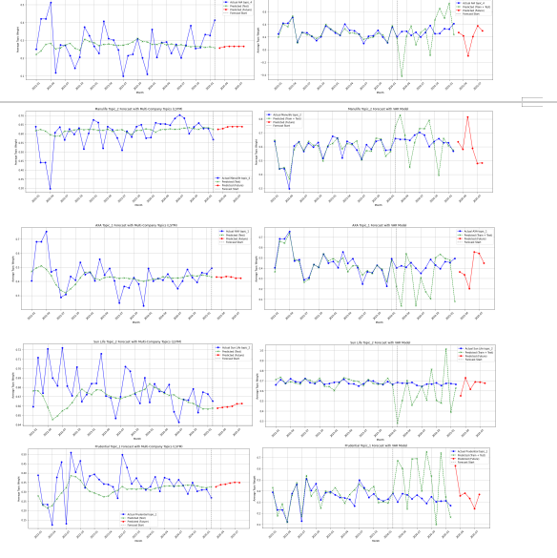
Forecast Comparison and Insights
LSTM Performance: The LSTM model generally achieved better quantitative accuracy, particularly in smoother and stable series (e.g., Sun Life). However, it tends to underperform in predicting local peaks or abrupt fluctuations, as its predictions appear more smoothed.
VAR Performance: The VAR model, although having higher RMSE and MAE values, captured fluctuations and spikes more sharply, which may reflect real-world volatility more realistically in certain contexts.

Slide 39
Future Research Directions
Based on the findings and limitations of this study, we propose the following directions for future research:
1. Multi-platform Analysis: Extend the analysis to include other social media platforms (Twitter, Facebook, specialized insurance forums) to capture a broader spectrum of customer opinions and reduce platform-specific biases.
2. Sentiment Analysis Integration: Combine topic modeling with sentiment analysis to not only identify what customers are discussing but also how they feel about these topics, providing a more nuanced understanding of consumer perceptions.
3. Hybrid Forecasting Models: Develop hybrid time series models that combine the strengths of LSTM (stability) and VAR (responsiveness to volatility) for more accurate prediction of future topic trends.
4.We csn also use Network Analysis to explore connections between key discussion topics and user interactions.

Slide 40
Thank You

